Slide 1
Healthy Churches Pray
1 Timothy 2:8-15
Preached by Dr. Jim Harmeling at Crossroads International Church Singapore • cicfamily.com Uploaded by Dr. Rick Griffith • Singapore Bible College Thousands of files in 49 languages for free at BibleStudyDownloads.org

Slide 2
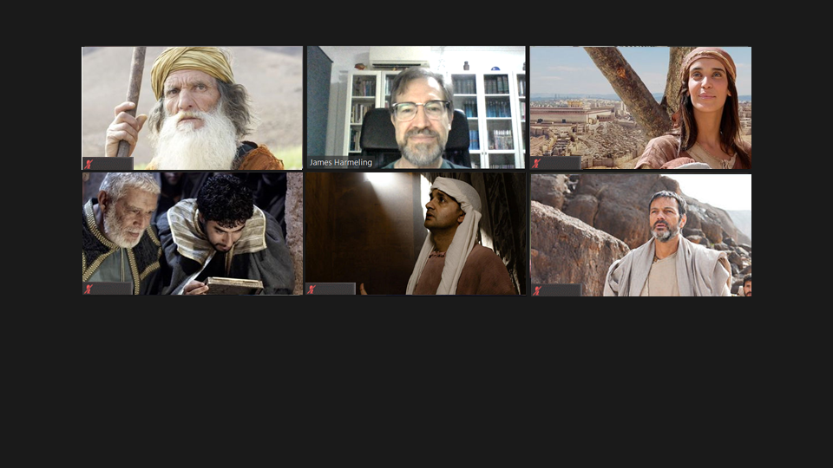
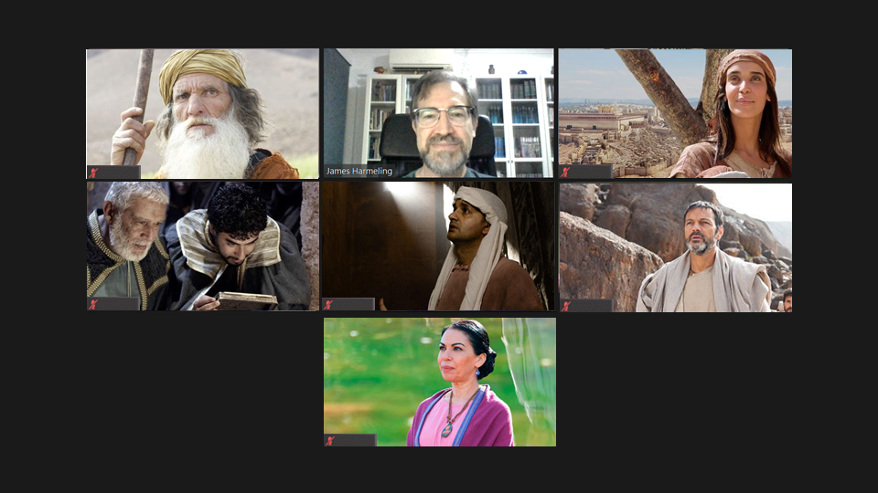
Are we a Zoom Church?
Is this unity?

Slide 3
Healthy Church Life
Studies in 1 Timothy

Slide 4
Healthy Churches Pray
1 Timothy 2:8-15

Slide 5
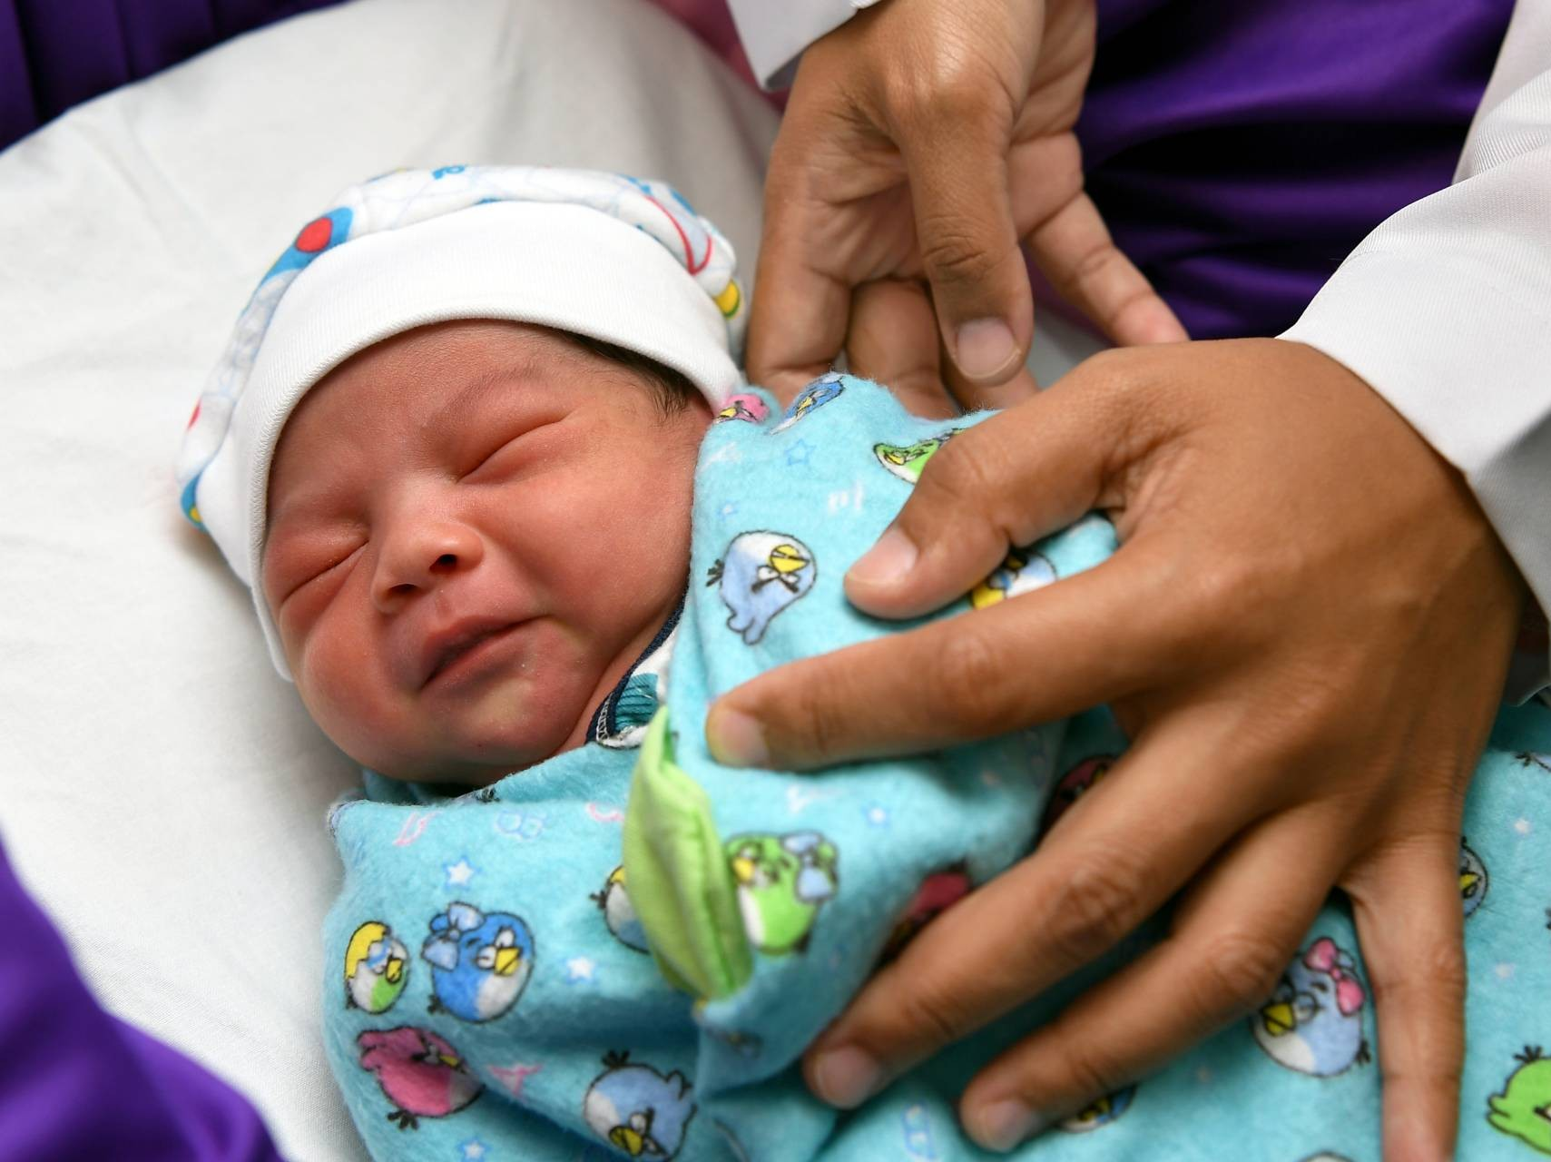
They Pray For Gospel Conversions (vs. 1-7)

Slide 6
They Pray with Unity (vs. 8-15)

Slide 7
Avoid needless, angry debates (2:8)
Be careful not to vainly draw attention to self (2:9-10)

Slide 8
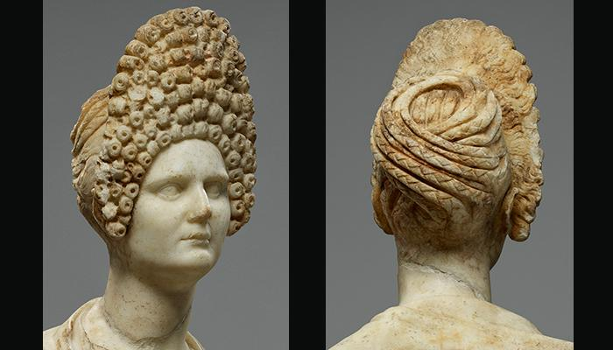
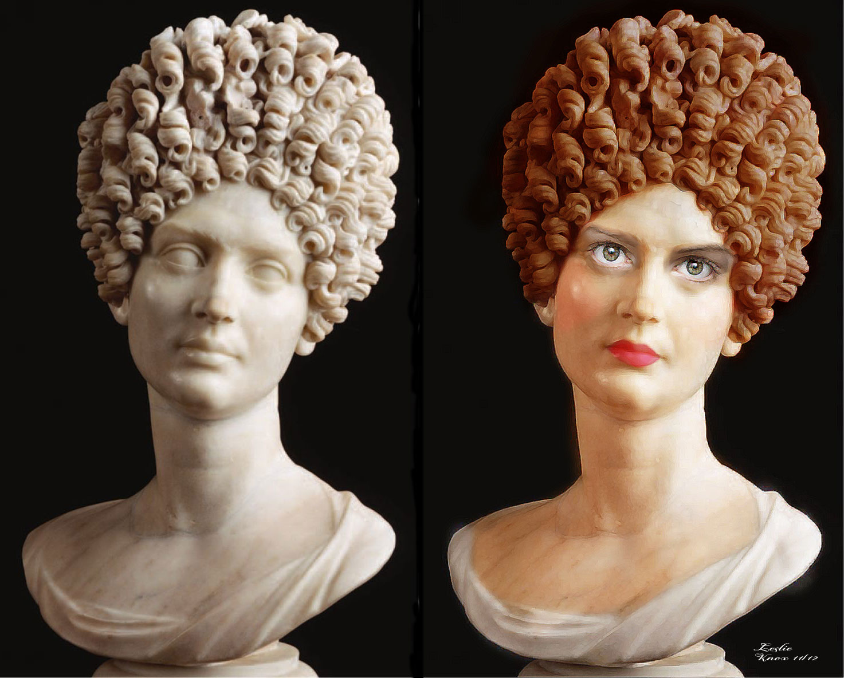

Slide 9
Avoid needless, angry debates (2:8)
Be careful not to vainly draw attention to self (2:9-10)
Accord with God’s revelation of gender roles (2:11-15)

Slide 10
Genesis 3:15
I will put enmity between you and the woman, and between your offspring and her offspring; he shall bruise your head, and you shall bruise his heel.”

Slide 12
NT Preaching • BibleStudyDownloads.org
Get this presentation for free!

